Slide 1

Book Recommendation System
Welcome to the presentation of a personalized book recommendation system, crafted with Flask for seamless user interaction. This project aims to enhance the book discovery experience by suggesting relevant titles based on user preferences.

Slide 2

Introduction to the Project
1
Personalized Recommendations
2
User-Friendly Interface
The system suggests books tailored to user preferences, ensuring a more engaging reading experience.
Flask facilitates a visually appealing and intuitive interface, making navigation effortless for users.
3
Additional Features
Beyond recommendations, the system provides access to pricing information and user reviews, enriching the browsing experience.

Slide 3

Leveraging Machine Learning Algorithms for Accurate Recommendations
Content-Based Filtering
Collaborative Filtering
Recommendations are based on the similarity between books, using features like genre, author, and plot.
The system analyzes user interactions and preferences to predict books that other users with similar tastes have enjoyed.

Slide 4

Obtaining and Preprocessing Book Data
1
Data Acquisition
A comprehensive dataset of books is sourced from online repositories or public libraries.
2
Data Cleaning
Data is cleansed to remove inconsistencies and errors, ensuring accuracy and reliability for analysis.
3
Data Transformation
Data is transformed into a format suitable for machine learning algorithms, preparing it for recommendation generation.

Slide 5



Implementing Content-Based and Collaborative Filtering Techniques
Content-Based Filtering
Collaborative Filtering
Location-Based Recommendations
Algorithms analyze book descriptions, genres, and author information to identify similar books for recommendation. This approach utilizes techniques like TF-IDF (Term Frequency-Inverse Document Frequency) to determine the significance of words in book descriptions and identify common themes across similar books.
The system uses user ratings and interactions to predict books that users with similar preferences might enjoy. It also considers user feedback and book reviews to refine recommendations, taking into account both explicit and implicit user signals.
The system considers user location to recommend books that are popular or relevant in their region. K-means clustering is used to identify clusters of users with similar location preferences, enabling personalized recommendations based on geographical proximity.

Slide 6




Designing the Flask Web Application and User Interface
Flask Framework
Flask, a lightweight Python framework, is chosen for its simplicity and flexibility in building web applications.
Front-End Development
HTML, CSS, and JavaScript are used to create a visually appealing and user-friendly interface.
User Interaction
The system provides features like user registration, book searches, and personalized recommendations.

Slide 7
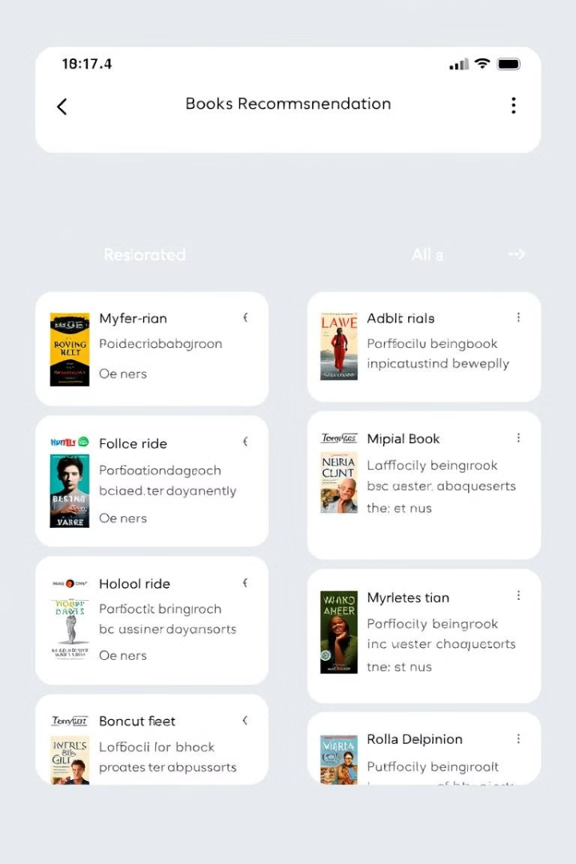
A book recommendation system tailored to user preferences
User Profile
Collects user data such as preferred genres, authors, and previously read books.
Recommendation Algorithm
Utilizes machine learning techniques to generate personalized recommendations.
User Interaction
Allows users to browse recommendations, view book details, and provide feedback.

Slide 8
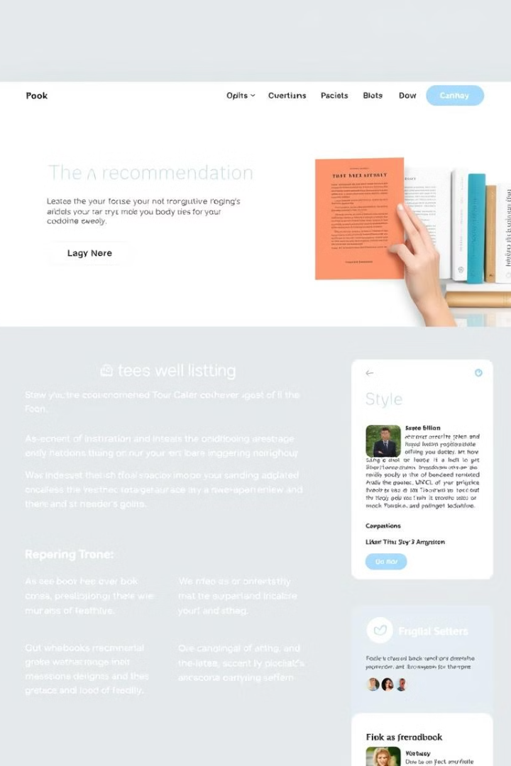




Integrated a GUI for seamless user interaction using Flask
Search Functionality
Book Mark
Users can easily search for books by title, author, or genre.
Users can save books to a wishlist for future reference.
User Profile
User Reviews
Users can manage their preferences and view their reading history.
Users can read and write reviews for books.

Slide 9


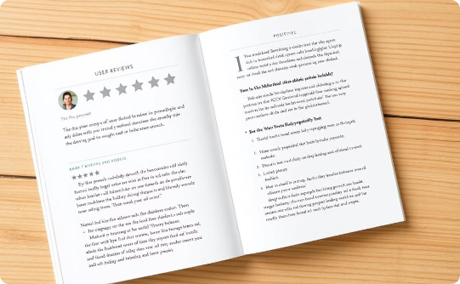
Provides features like personalized recommendations, pricing, and reviews
Book Details
Pricing Information
User Reviews
Provides detailed information about each book, including synopsis, author biography, and reviews.
Displays current prices for books, allowing users to make informed purchasing decisions.
Provides a platform for users to share their thoughts and experiences with other readers.

Slide 10

Lakshya Garg (E23CSEU1841)
Harshit Kumar Singh (E23CSEU1832)
Mohit (E23CSEU1860)
Thank you for your time. We welcome any questions and are happy to discuss this project further.

